Slide 1
Title: FIGHTING MISINFORMATION WITH NATURAL LANGUAGE PROCESSING AND MACHINE LEARNING
Team Members:
Penumatsa Krishnamraju
Gujjula Madhubala
Kotha Sindhu
Chalasani Mounisha
Adulla Manisha
Instructor: Haihua Chen

Slide 2
Table of Content
Abstract
Introduction
What is MISINFORMATION?
Problem Overview
How to detect Misinformation?
Current Solutions Analysis
Limitations of current solutions
Conclusion
GitHub Link and author contributions

Slide 3
Abstract
In recent years, the spreading of false information has become a concerning phenomenon, giving rise to the use of terms like misinformation, disinformation, and fake news. Although information professionals have been asked to take the lead in the battle against false news, existing efforts have been fragmented and ineffective due to a lack of a thorough grasp of the situation. Most information behaviour models focus on information, not false information.

Slide 4
Introduction
As the field's own research topics have evolved over time, so has social science research. The classic analysis methods need to be revised and adjusted for the current era due to the emergence of social networks, new media, technological developments, and various forms of media consumption, among other changes.
The investigation of fake news and disinformation in its broadest sense, from its creation to the consequences it has on citizens, is one of the subjects currently generating the most attention in the scientific community. Many authors investigate what makes someone more or less susceptible to misinformation.

Slide 5
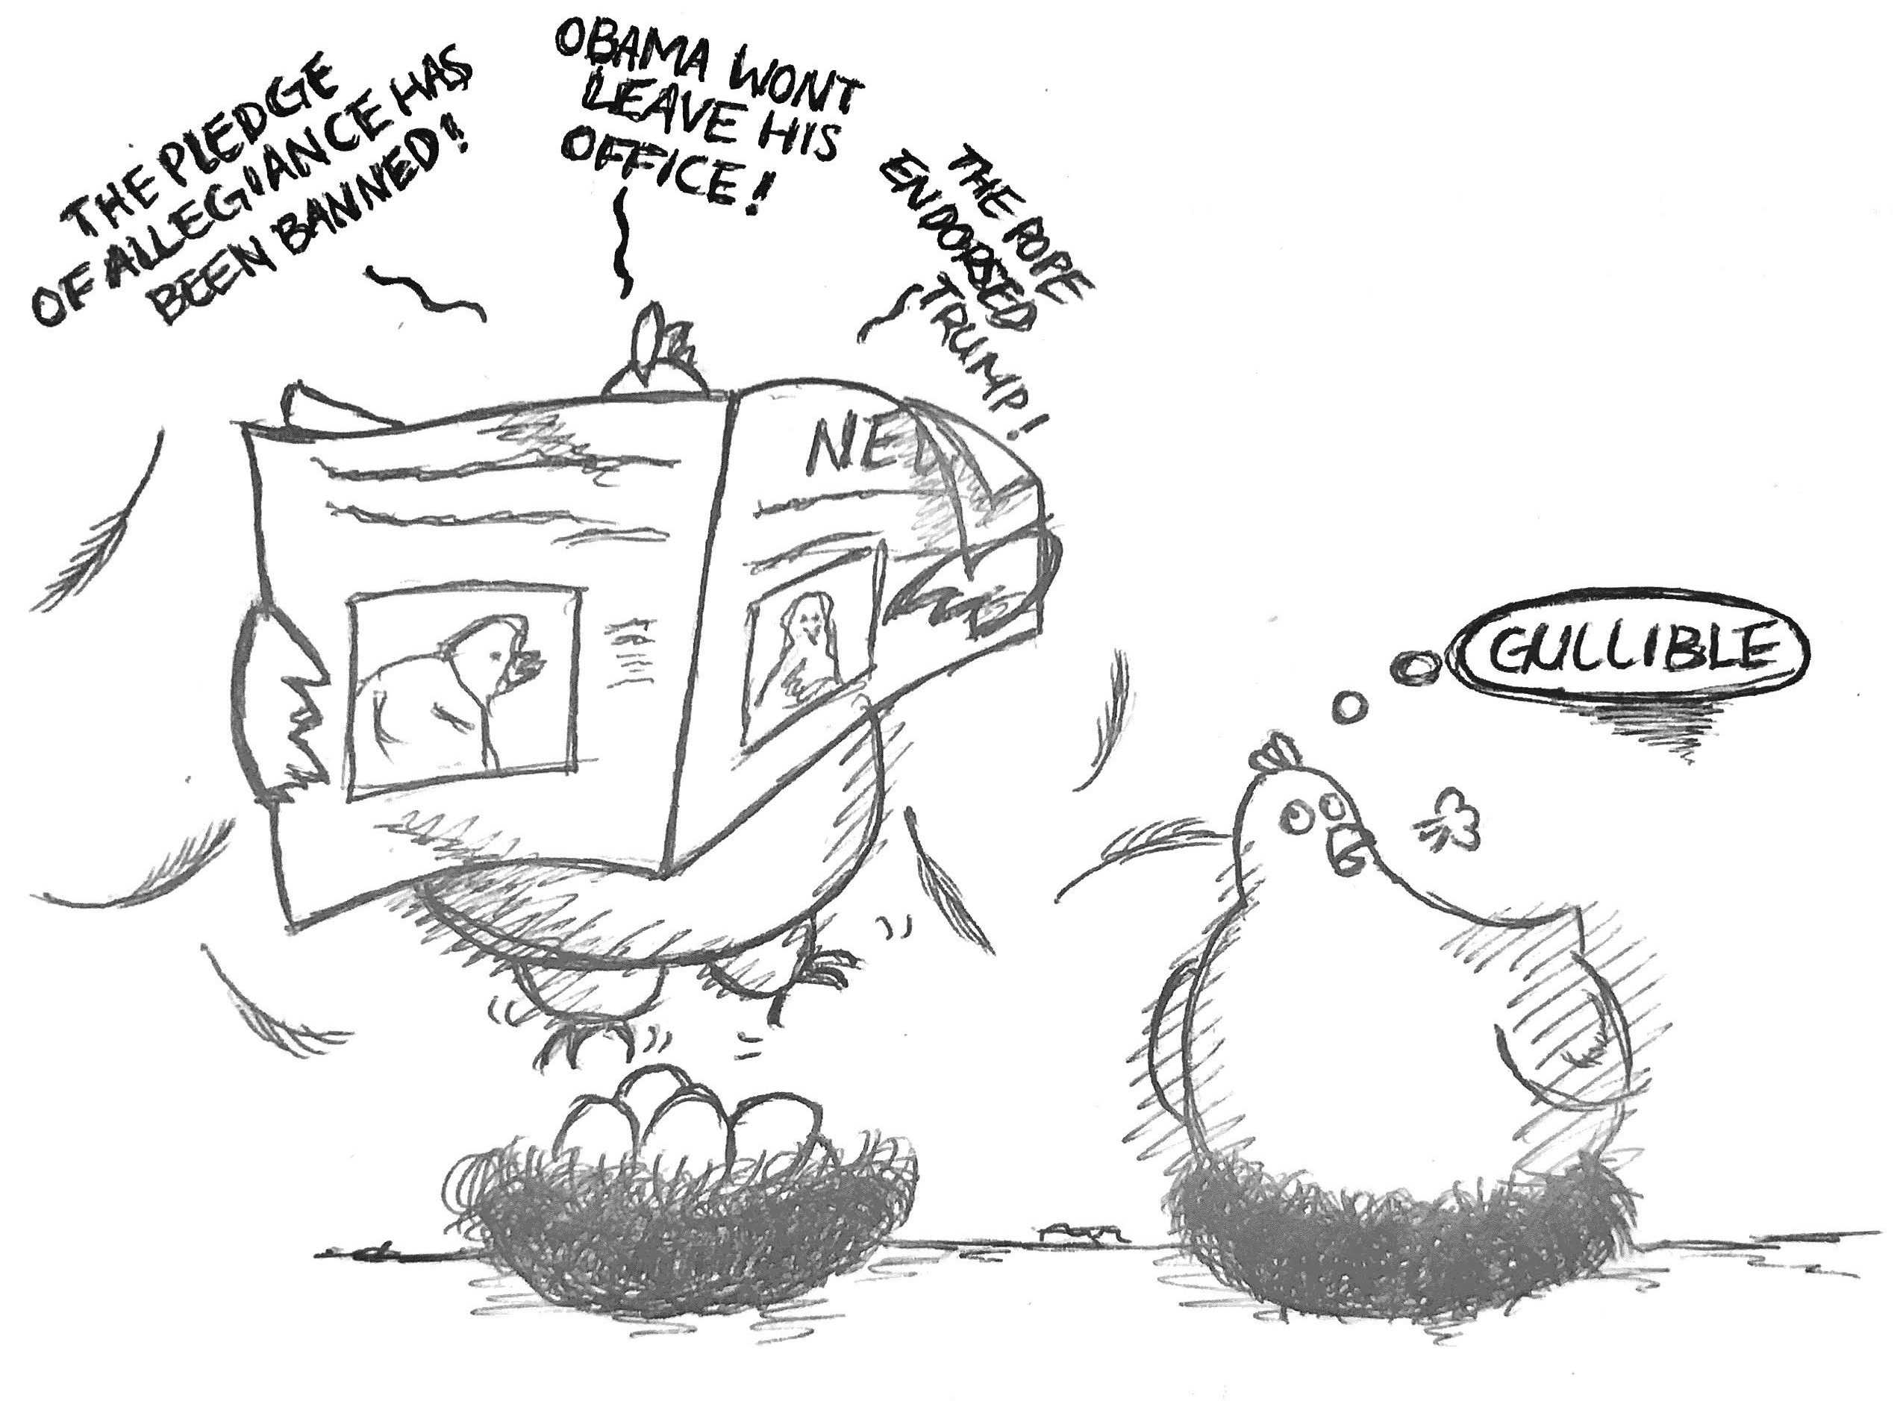
What is MISINFORMAION?
Misinformation: False or incorrect information
Purpose: Affect the perception of people

Slide 6
Problem Overview:
The large use of Online Social Networking has provided fertile soil for the emergence and fast spread of rumors.
It is difficult to determine all of the messages or posts on social media are truthful.
Fake news Harms to real life.

Slide 7

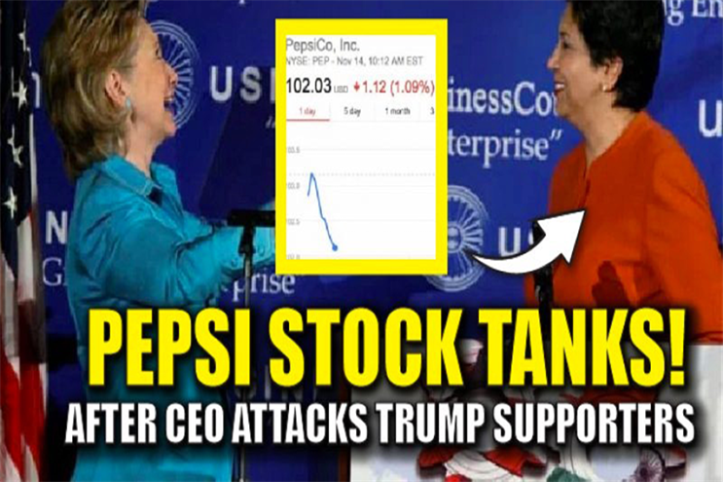
Sweden signed the deal to become a member of NATO??
Defend Misinformation!
PepsiCo CEO indra Nooyi told Trump fans to “take their business elsewhere”

Slide 8
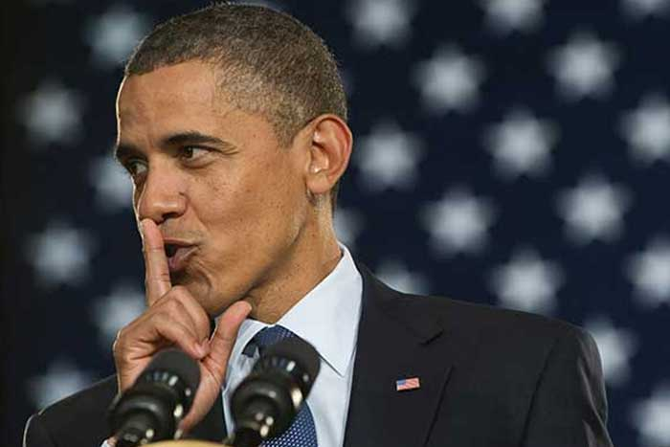
How to detect misinformation?
“As Obama bows to Muslim leaders Americans are less safe not only at home but also overseas. Note: The terror alert in Europe... ”
b. “RT @johnnyA99 Ann Coulter Tells Larry King Why People Think Obama Is A Muslim http://bit.ly/9rs6pa

Slide 9
Current Solutions
Linguistic approaches
Data Representation
Deep Syntax
Semantic Analysis
Rhetorical Structure and Discourse Analysis
Classifers
Topic Modeling Techniques

Slide 10
Limitations of current solutions
Clustering data by keywords using an ensemble method that combine user, propagation and content-based features could be effective.
Computation of those features is efficient, but needs repeated responses by other users.
Results in increased latency between publication and detection.
Current studies focus on improving accuracy, but the accuracy of current techniques is still below 70%.
Ambiguity in the language. Evolving usage of Language: e.g. Emoticons, Symbols
Difficulty in classification

Slide 11
Conclusion
Linguistic and network-based approaches have shown relatively high accuracy results in classification tasks within limited domains.
Previous studies provide a basic topology of methods available
New tool - Refine, Evolve and Design
Hybrid System - Techniques arising from disparate approaches may be utilized together.

Slide 12
GitHub Link : https://github.com/MadhuUNT/INFO-5731-Fall-22/tree/main/Term%20Project
Author Contributions:
Kirshamraju was involved in the development of the introduction, literature review, and research methods.
Sindhu was involved in the development of literature review.
Mounisha was involved in the development of the research questions and data collection.
Madhubala was involved in the development of the research methods.
Manisha was involved in the development of the experiment and data analysis plan.

Slide 13
THANK YOU!

